Slide 1
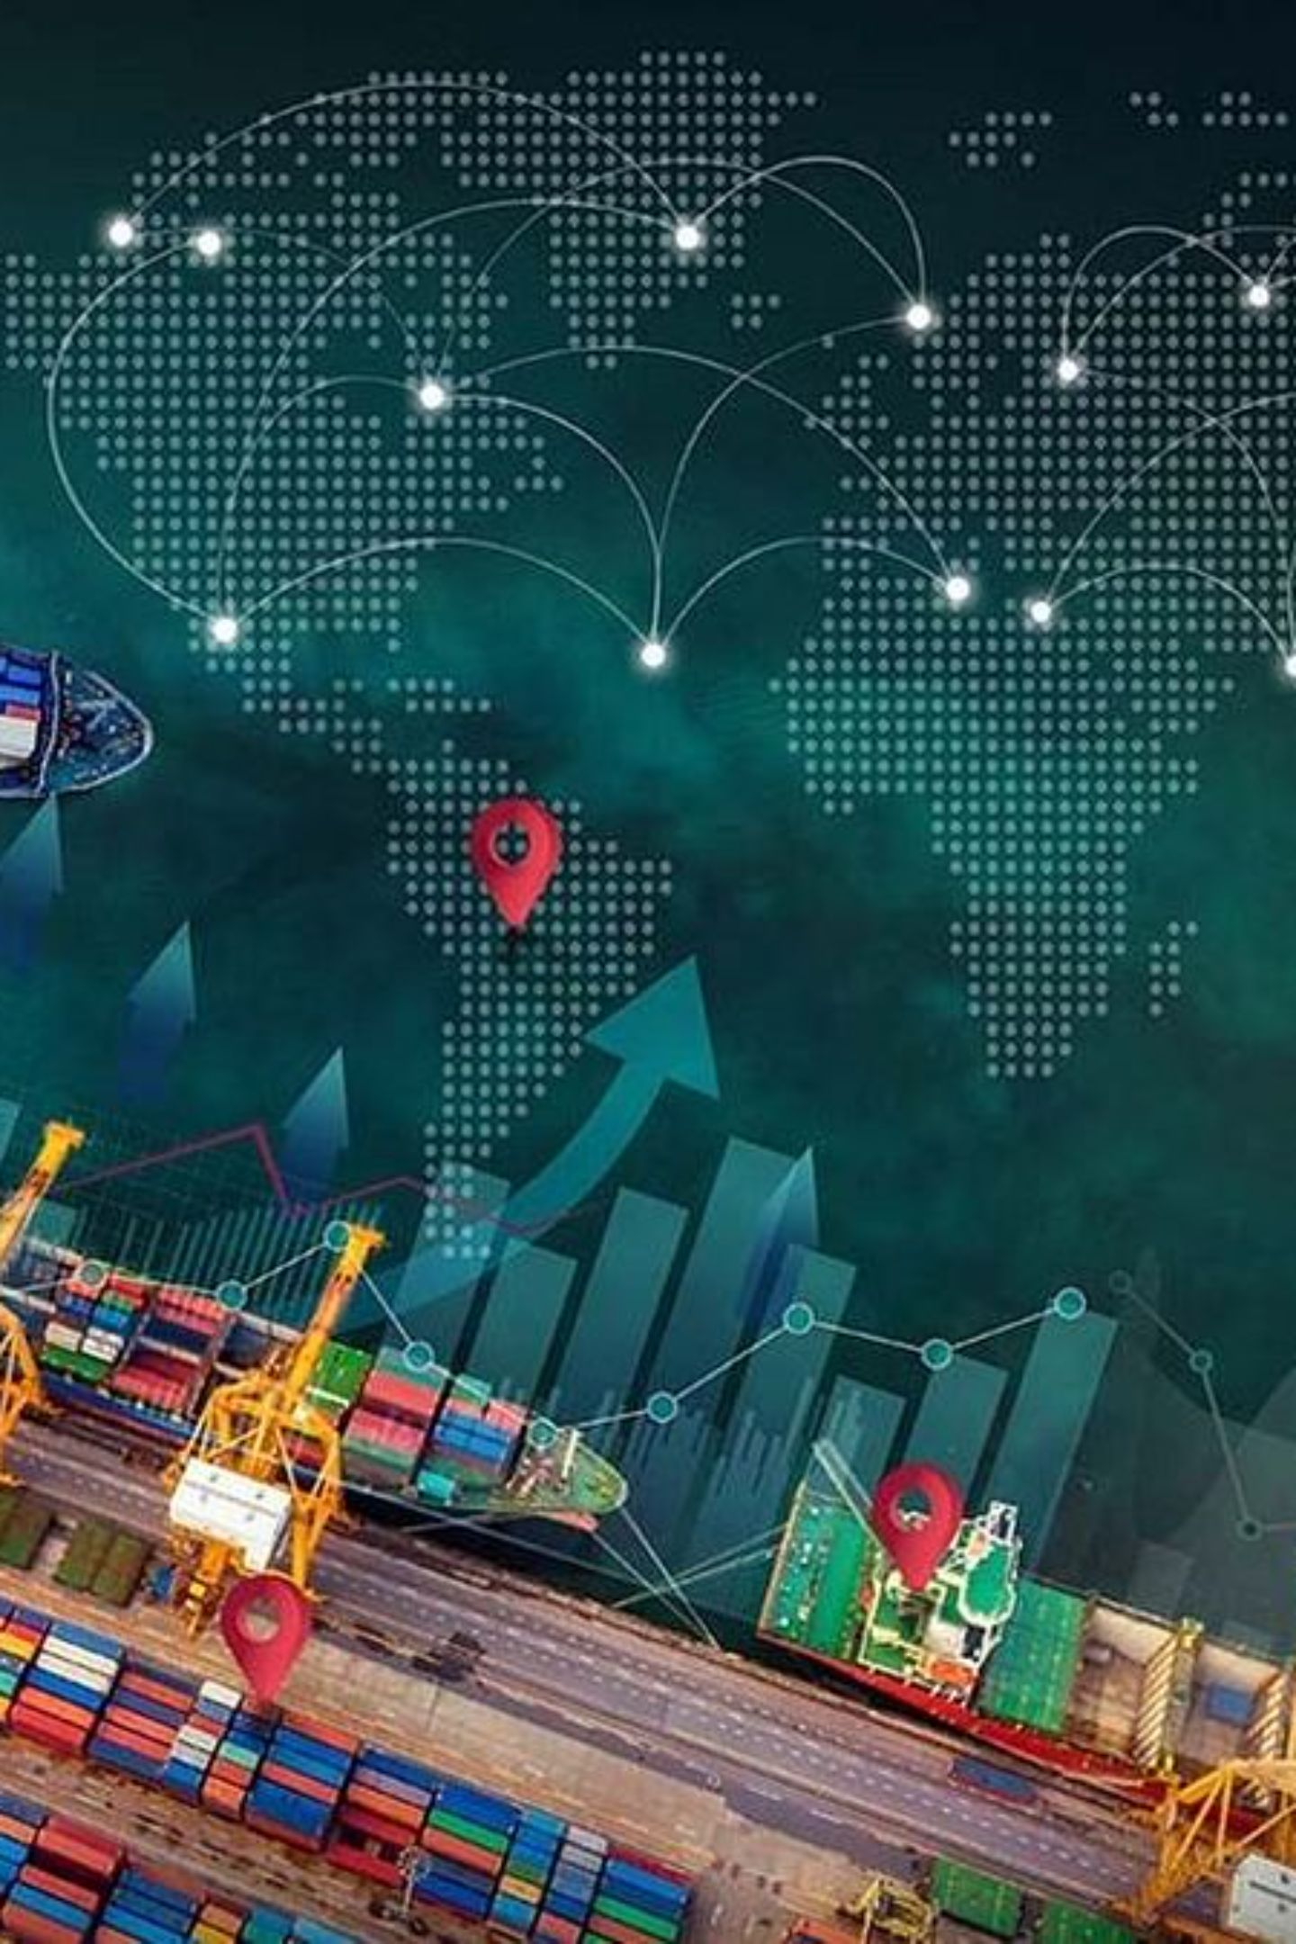
Infosys Springboard • Virtual Internship 7.0
Supply Chain Visibility System with Optimization Analytics
A Power BI-based system that analyzes supply-chain data to improve visibility, identify bottlenecks, and support decisions.
Team D • Group 1
Mentor - Ms. Nityasree
Umeshwaran R
Uppala Bhavya Sri
V. Charita Sree
Velpuri Sai Rohitha
Venkata Puneeth Kothapalli
Yuvasree P

Slide 2


Project Objective
Our Project Focus
Workstream Breakdown
Monitor the overall supply chain in one platform.
Track inventory, orders, suppliers, and deliveries.
Identify delays, bottlenecks, and operational inefficiencies.
Optimize resources and support better business decisions.
Supply Chain Monitoring
Inventory Management
Order & Delivery Tracking
Supplier Performance Analysis
Optimization & Analytics

Slide 3
Project Execution Milestones
Milestone 1 – Data Acquisition & Cleaning
Milestone 2 – Data Modeling
Organized data into a structured model by defining relationships between datasets and arranging fields for accurate analysis and KPI generation.
Collected supply-chain data and prepared it by correcting missing values, eliminating duplicates, removing irrelevant fields, and maintaining consistent formats.
Milestone 3 – Development
Milestone 4 – Review & Optimization
Built the Power BI dashboard with interactive KPIs, charts, and analytical views to monitor shipments, inventory, suppliers, transportation, costs, and product performance.
Analyzed dashboard results to identify trends and operational issues, then refined the model and visualizations to improve clarity and usefulness of insights.

Slide 4
Challenges & Resolutions
Challenges
Resolutions
1
Incomplete & Inconsistent Data
1
Data Cleaning & Standardization
Missing values, duplicate records, and inconsistent formats affected the accuracy of analysis.
Handled missing and duplicate data and standardized formats to improve data quality.
2
Complex Supply Chain Data
2
Structured Data Modeling
Data from inventory, suppliers, orders, transportation, and deliveries was difficult to organize and analyze together.
Organized related datasets and created suitable relationships for efficient analysis and reporting.
3
KPI-Based Analytics
3
Identifying Actionable Insights
Used relevant KPIs, dashboards, and visualizations to highlight trends, bottlenecks, and areas for improvement.
Large amounts of data made it difficult to identify important delays, bottlenecks, and inefficiencies.

Slide 5



Future Enhancements & Key Insights
Future Enhancements
Key Insights
Real-Time Tracking
Operational Visibility
Integrate real-time tracking for shipments and deliveries.
Analyzing shipment and delivery activities helps reveal recurring patterns and areas where delays may occur.
Demand Forecasting
Add demand forecasting for better inventory planning.
Supply Chain Performance
Automated Alerts
Supplier reliability and transportation efficiency have a significant impact on smooth operations and timely deliveries.
Introduce automated alerts for delays and supply-chain risks.
Predictive Analytics
Improvement Areas
Apply predictive analytics to optimize logistics and costs.
Examining inventory, costs, and product performance helps identify specific opportunities to improve overall supply-chain efficiency.

Slide 6








Conclusion
The Supply Chain Visibility System transformed raw supply-chain data into an interactive Power BI Dashboard. It provides better visibility into inventory, suppliers, shipments, transportation, and deliveries. The analysis helps identify operational trends, performance gaps, and potential bottlenecks. Overall, the project supports more effective data-driven supply-chain decisions.
Technical Capabilities Strengthened
Professional Skills Applied
Power BI Dashboard Development
Data Preprocessing & Modelling
Problem Solving
Communication
Teamwork
Presentation
DAX and Data Visualization
Data Analysis

Slide 7


Acknowledgements & References
Acknowledgements
References
Infosys Springboard – Virtual Internship 7.0
Mentor: Ms. Nityasree
Team D – Group 1
Supply Chain Dataset
Microsoft Power BI
The project analysis was performed using supply-chain data covering shipments, inventory, suppliers, products, transportation, costs, and deliveries.
Microsoft Power BI documentation was referred to for dashboard development, DAX implementation, and data-modeling concepts.
Uppala Bhavya Sri
V. Charita Sree
Velpuri Sai Rohitha
Venkata Puneeth Kothapalli
Yuvasree P
Infosys Springboard
Power BI Resources
The Infosys Springboard learning materials supported the project as part of the Virtual Internship 7.0 program.
Additional Power BI resources were consulted to support data modeling, visualization, and optimization during project development.

Slide 8
Thank You
Supply Chain Visibility System with Optimization Analytics
Team D • Group 1 | Infosys Springboard Virtual Internship 7.0
Mentor: Ms. Nityasree

